Slide 1

A REPORT ON IPL DATA ANALYSIS
NISHANTH D KINI

Slide 2

CONTENTS
Introduction
Brief description about topic
Acknowledgement
4. Outcomes

Slide 3
Introduction
As we know that this is the season of the most popular league in
Cricketing history IPL . So it’s a great opportunity to create an
Interesting project in PYTHON about Analyzing IPL Data.
This can be done in any IDE .It involves about how do the stats be
Involved in calculating the team requirements like the number of
Matches played, the man of the match for each game from start to the
End , the number of wins and losses etc…

Slide 4
Brief description…
In this project, analyzing the IPL data would be done.Firstly there would be
a table consisting of the ,matches to be played, the teams participating in the
Ipl, then the stadium in which the match is about to played or is played.
Then we have the result or the winners of each game.There would be the
MAN OF THE MATCH for each game.This is a 2-3 year IPL record table.
Firstly we would be importing all the libraries required for the project like
Pandas, pyplot and seaborn.Then we would create a separate file for linking the
Table created.The separate file would be matches.csv and we would link it to this
File through ipl=pd.read_csv(matches.csv).
import pandas as pd
from matplotlib import pyplot as plt
import seaborn as sns

Slide 5
Then we can extract any data from the table by typing in the particular functions
Required for the same,like extracting the data of the team with most wins, most
Man of the matches ,matches won by teams batting first,matches won by teams
Batting second etc..
Then we would also be creating graphs like pie chart,bar graphs ,histogram which
Will compare the most wins by teams batting first or second etc..
For eg:#making a bar-plot for the top 5 players with most man of the match awards
plt.figure(figsize=(8,5)) plt.bar((ipl['player_of_match'].value_counts()[0:5].keys()),
(ipl['player_of_match'].value_counts()[0:5]),color="g") plt.show()

Slide 6
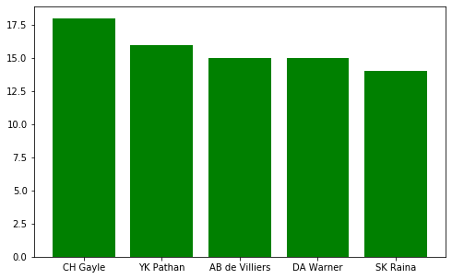
The required bar plot
Will be →
Similarly other data can also be accessed through this method…..

Slide 7
ACKNOWLEDGEMENT
I would like to thank the people behind helping me in this project.
Firstly I would Like to thank our principal for having given me an
opportunity to do this project.
Next I would like to thank Brunda maam who teaches us Python course, for
having given me a chance to choose this topic and clearing my petty doubts.
Then I would like to thank my parents and my friends for supporting me in this
Project.

Slide 8
OUTCOMES…..
-> This project mainly deals with an application of Python in IPL DATA ANALYSIS.
->It gives the result of a data manipulator like it gives the count of the most wins,
losses, most man of match winners etc.
->It is used to get the top scorers of the match.
->It is used to check the consistency of each player and team involved.
->It also gives the details in the form of pie chart, bar graph which makes
analyzing much more simpler.
->It also gives the details of each ball in an over faced.
-> Similarly it is used to access many other details of the match.
.

